Slide 1
Data 100 Principles & Techniques of Data Science
?
Slides by:
Joseph E. Gonzalez
jegonzal@cs.berkeley.edu

Slide 2
Questions for Today
Why am I excited about Data Science?
What is Data Science?
Who are we?
What does it mean to be a data scientists today?
Break
What will I learn and how?
Demo (who are you?)!
Slides from lecture available online at http://ds100.org/sp18

Slide 3
Data is Changing the World
Why am I excited about Data Science?

Slide 4
Where should I eat?
Where can I get the best burrito in SF?
Each ratings star added on a Yelp restaurant review translated to anywhere from a 5 percent to 9 percent effect on revenues.
-- Harvard Business School
Learn about eating the dangers of eating
In SF in 2nd homework …
http://hbswk.hbs.edu/item/the-yelp-factor-are-consumer-reviews-good-for-business

Slide 5
Data can help address climate change …
By tracking sales data on energy efficient appliances, data for climate action is helping guide urban campaigns to educate the general public and measure changes in purchasing behavior.
http://www.dataforclimateaction.org

Slide 6
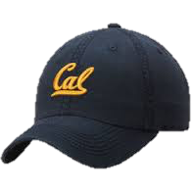
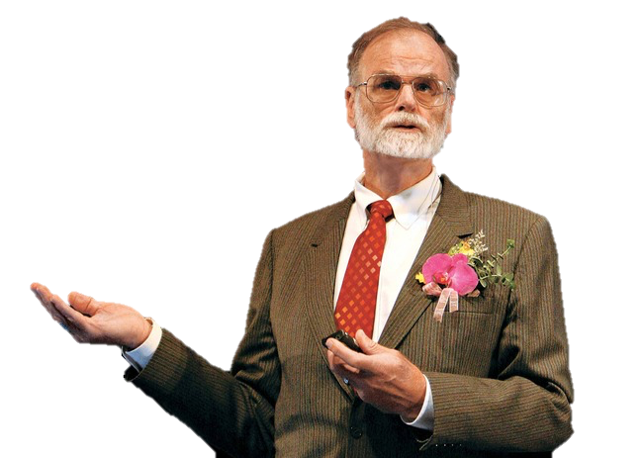
Data Science is
transfroming Science
Jim Gray Turing Award Winning Computer Scientist
& Cal Alum.

Slide 7

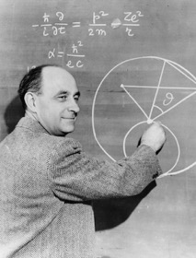
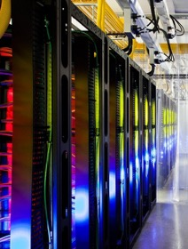

Introduced the idea of the Fourth Paradigm of Science
Experimental
Theoretical
Simulation
Data
Intensive
Jim Gray
Notes:
http://www.nytimes.com/2009/12/15/science/15books.html

Slide 8
Astronomy in the 4th Paradigm
+
Sky Server
Sloan Digital
Sky Survey (SDSS)
Database
Systems
Notes:
http://www.nytimes.com/2009/12/15/science/15books.html

Slide 9
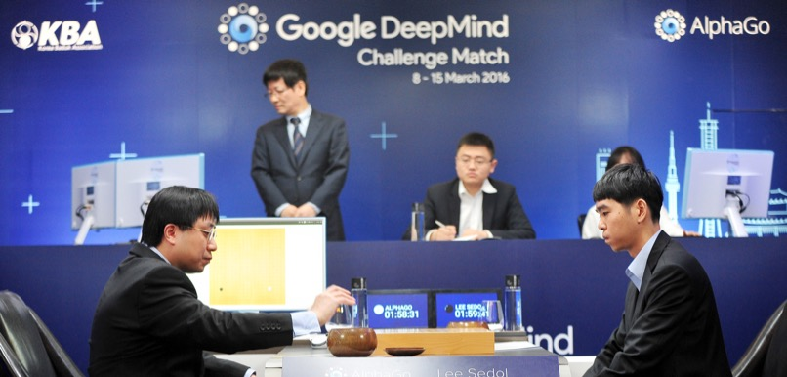
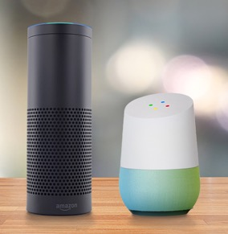
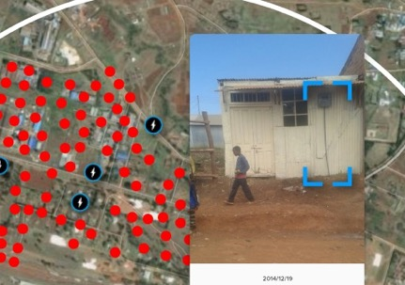
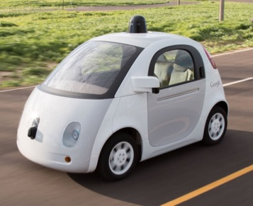
Technology Trends
2020s
?
2010s
Data Industry
Collect and sell information
2000s
Internet Industry
Online retailers and services
1990s
Software Industry
Sold computer software
1980s
Hardware Industry
Sold computers
Notes:
1970s → Rise of the PDP 11
1980s → Apple II, NEC, IBM PC …
1980s → Lotus 1-2-3,

Slide 10
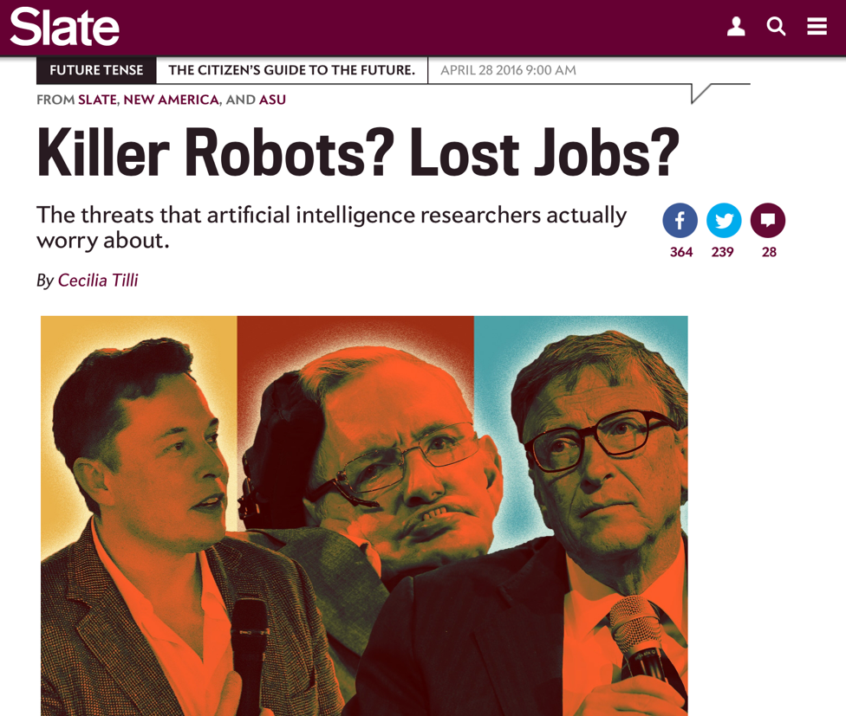
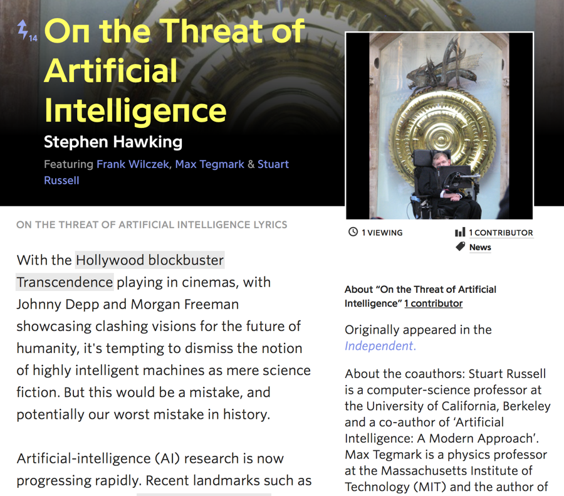
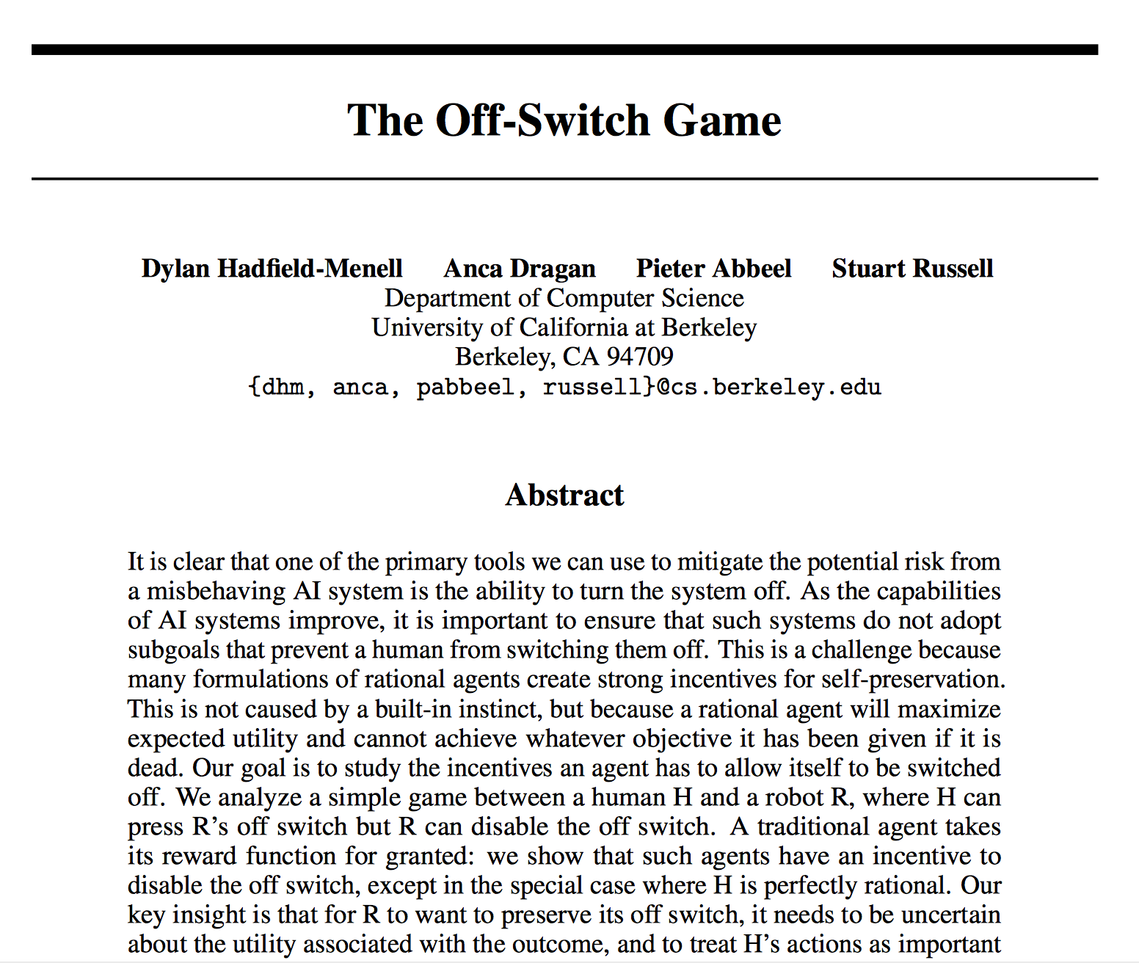
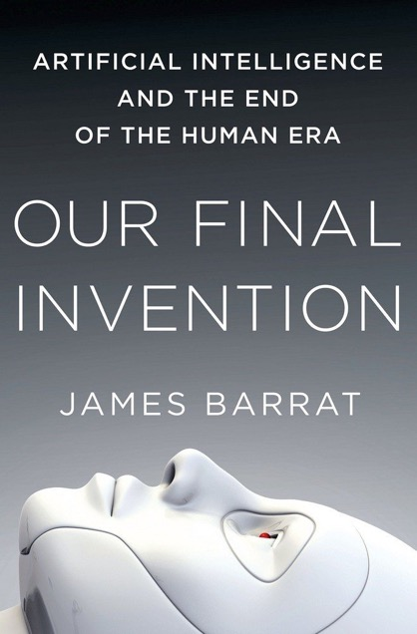
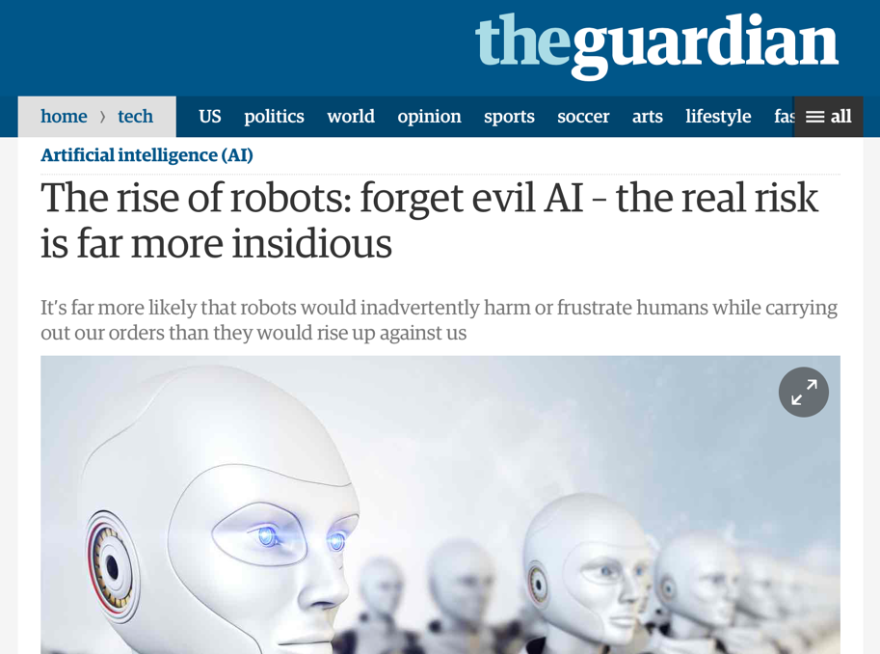
Real concern?
There are more immediate concerns.

Slide 11
The Darker Side of Data Science
Obscuring complex decisions
Mortgage backed securities → market crash
Teaching scores & job advancement
Reinforcing historical trends and biases
Hiring based on previous hiring data
Recidivism and racially biased sentencing
Social media, news, and politics
We will touch on the ethics of data science throughout the class
http://www.npr.org/2016/09/12/493654950/weapons-of-math-destruction-outlines-dangers-of-relying-on-data-analytics

Slide 12
But … I am optimistic
Knowledge is empowering
Data science offers immense potential to address challenging problems facing society
The future is in your hands and I believe
You will use your knowledge for good.
… I am thrilled to teach Data 100!

Slide 13
What is Data Science?
The recurring question across industry and academia.

Slide 14
My Definition for Data Science
The application of data centric, computational, and inferential thinking to
understand
the world
solve
problems
&
Science
Engineering
Data science is fundamentally interdisciplinary

Slide 15
Skills of Data Science
Computer
Science
Statistics

Slide 16
Skills of Data Science
Domain Expertise
Machine Learning
Computer
Science
Statistics

Slide 17
Skills of Data Science
Domain Expertise
Danger Zone!
Research
Analyst
Data
Science
Computer
Science
Machine Learning
Statistics
Drew Conway’s Venn Diagram of Data Science
Notes:
http://drewconway.com “Drew Conway, CEO and founder of Allluvium, is a leading expert in the application of computational methods to social and behavioral problems at large-scale. Drew has been writing and speaking about the role of data — and the discipline of data science — in industry, government, and academia for several years.”

Slide 18
Who are we?

Slide 19
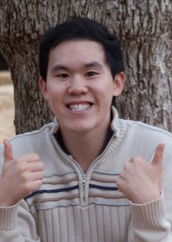
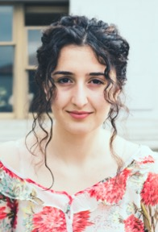
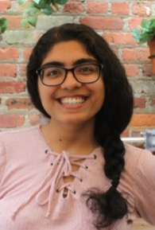

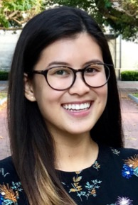

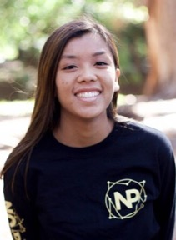


The Data 100 Team
☺
Joseph
Gonzalez
Fernando
Perez
Aman
Dhar
Andrew
Do
Edward Fang
Manana
Hakobyan
Sona
Jeswani
Biye
Jiang
Joyce
Lo
?
?
?
Simon Mo
Nhi
Quach
Louis Rémus
Caleb
Siu
Jake
Soloff
Weiwei
Zhang
TBD
TBD
TBD

Slide 20
Joey Gonzalez
Joined EECS at UC Berkeley in 2016
Research Area: Machine Learning & Data Systems
Study design of scalable systems for machine learning
Algorithms: designed parallel algorithms for statistical inference
Abstractions: introduced vertex programming & parameter server
Systems: developed GraphLab and parts of Apache Spark
Co-Founder of Turi Inc.
Python tools for scalable data science
Acquired by Apple Inc. in 2016

Slide 21
What does it mean to be a data scientist today?
How can we answer this question?

Slide 22
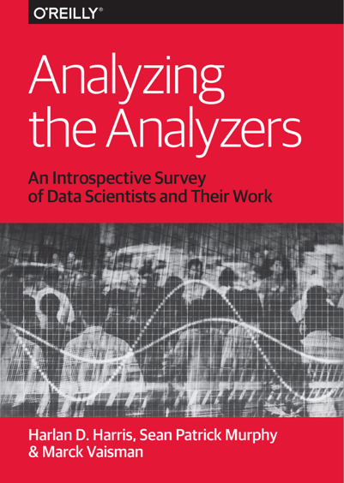
O’REILLY Surveys
Asked people involved in data science events to complete an online survey
Self reported → Selection bias!
Still somewhat interesting …
983 Individuals
250 Individuals
O’Reilly is a good source recent materials on data science.

Slide 23
There is a lot of excitement around Big Data … how big is the data?

Slide 24
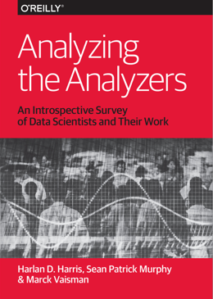
Scale of Data
Not usually big!
< 1GB
However some data scientists frequently process TB to PB data sets.

Slide 25
What do they do?
How involved are you in task ___:
(a) Major, (b) Minor, (c) None
Developing Models
Implementing ML Algorithms
Visualization
Exploratory Data Analysis (EDA)
Researching Questions
Writing Reports,
…

Slide 26
How involved are you in task ___:
(a) Major, (b) Minor, (c) None

Slide 27
How involved are you in task ___:
(a) Major, (b) Minor, (c) None
Are the top items surprising?
Data Cleaning ☹
Where are Modeling / Prediction?

Slide 28
Less than half of respondents had major involvement in ML activities!
How involved are you in task ___:
(a) Major, (b) Minor, (c) None
However, developing prototype Models had the greatest impact on predicted salary
major engagement → $7.4K boost

Slide 29
What tools do they use?
Programming Languages
Machine Learning

Slide 30
Programming Languages

Slide 31
Programming Languages
SQL > R > Python
Cluster Analysis:
Python > R: data scientists
R > Python: analysts
Python users had higher salaries.
Highest Paid?
Scala

Slide 32
Machine Learning
Libraries

Slide 33
Machine Learning
Libraries
Scikit-learn used most
Used in DS100

Slide 34
That was my company →
Machine Learning
Libraries
Scikit-learn used most
Used in DS100

Slide 35
What is their annual income?

Slide 36
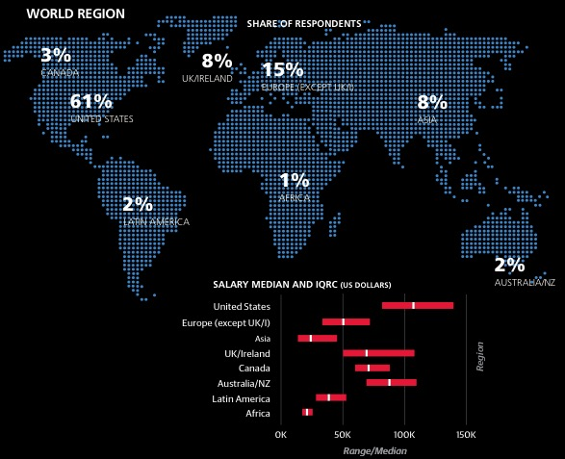
Salary Depends on Location and Industry

Slide 37
Intermission
5 Minute Break.
Ask a neighbor:
Contemplate:
What is your name?
What are the ethics of data science?
tabs or Spaces …?
Can data do harm?
What do statisticians and pirates have in common?
What do you want to get out of Data 100?

Slide 38
Pirates say

Slide 39
Important Administrative Reminders
There will not be any labs or sections this week
We will be computing optimal assignments for lab & section
complete the online section assignment poll
https://goo.gl/forms/YohOCvkrUia4zTeI2
Signup for the DS100 Sp18 Piazza Page
https://piazza.com/berkeley/spring2018/ds100/home
Homework 1 will go out next week and be due the following week.
You may start to setup your Python environment

Slide 40
What are your goals for DS100?
What do you want to learn?
How does this class fit into your future plans?

Slide 41
Our Goals
Prepare students for advanced Berkeley courses in data-management, machine learning, and statistics, by providing the necessary foundation and context
Enable students to start careers as data scientists by providing experience in working with real data, tools, and techniques.
Empower students to apply computational and inferential thinking to address real-world problems

Slide 42
What are the Prereqs. for Data 100
Officially Listed Prerequisites:
Foundations in Data Science [Data8]
Computing [CS61a or CS88 or … E7]
Calculus and Linear Algebra [Math 54 or EE16a or Stat 88]
We will not be enforcing prerequisites
… however you should be familiar with the material in these classes (especially Data8)
Homework 1 will help verify your familiarity
Do Hw1 and skim the Data8 textbook: https://www.inferentialthinking.com

Slide 43
What will I learn?

Slide 44
Topics covered in Data 100
Data collection and sampling
Data cleaning and manipulation
Regular Expressions
SQL and Enterprise Data Management
Xpath and web-scraping
Exploratory Data Analysis & Visualization
Hypothesis Testing & Confidence Int.
Model design & loss formulation
Batch and Stochastic Gradient Descent
Ordinary Least Squares Regression
Logistic Regression
Feature Engineering
The Bias - Variance Tradeoff & overfitting
Regularization & Cross validation

Slide 45
We will use Real Data
Homework, labs, and in class examples will build on real data:
Twitter, Speeches, Scientific Data, Maps, Surveys, Images, …
The data will be:
messy and you will have to clean it
big(ish) and you will have to be a little clever to process it
complicated and you will have to learn about the domain

Slide 46
You will Learn How to Use Real Tools
Focus on Python programming language
We will use various different technologies
Jupyter notebooks, pandas, numpy, matplotlib, postgres, seaborn, scikit-learn, plotly, Dask, …
We won’t teach you everything …
You will learn to read documentation
You will learn to teach yourself
BETA WARNING: Things will break …
You will learn how to debug
You will learn how to get help (on Piazza)
Notes:
Look into plotly and tableau

Slide 47
Reading and Reference Materials
No single great book (working on a Data 100 gitbook …)
Lectures slides and screencasts will be available on online
Use online reference materials
We will occasionally (in a few lectures) reference a few ebooks
Joel Grus. “Data Science from Scratch” [eBook Link]
Cathy O’Neil and Rachel Schutt. “Doing Data Science” [eBook Link]
G. James, D. Witten, T. Hastie and R. Tibshirani. “An Introduction to Statistical Learning.” [pdf Link]
Wes McKinney. “Python for Data Analysis” [pdf link]

Slide 48
Grades
[20%] 6 Homework assignments (drop the lowest)
[10%] 2 Projects (multi-week homework's)
[10%] Labs (Graded on Completion)
[5%] Vitamins (weekly online quizzes)
[5%] In class participation
Participate in at least 18 of the lectures for full credit.
Using google forms or bcourses (bring a browser)
[20%] 1 Midterm (in class)
[30%] 1 Final

Slide 49
On Time Policy (don’t be late)
5 days of “slip-time” to be used on homework/projects for unforeseen circumstances (e.g., get sick or deadline conflicts)
After you have used your slip-time budget
20% per day for each late day
If you are having trouble finishing assignments on time let us know!

Slide 50
Collaboration Policy: Don’t Cheat!
Data Science is a collaborative activity
You may discuss problems with friends
List their names at the top of your assignments
We may periodically analyze the collaboration networks
You must write your solutions individually
Don’t Cheat
Content in the homework and vitamins will be on the midterm and final
If you are struggling let us know so we can help!

Slide 51
Staying Up to Date
All communication will be through Piazza
https://piazza.com/berkeley/spring2018/ds100/home
If you have questions about assignments
Try commenting on the appropriate discussion
Do not share your code publicly
If you have private question → write a private post on Piazza
This will ensure a quick response
We will also be updating the website with links to homework, lectures, and vitamins
http://www.ds100.org/sp18/

Slide 52
Data Science Lifecycle
High-level description of the data science workflow

Slide 53
Ask a Question
Obtain Data
Understand
the World
Understand
the Data
Reports, Decisions,
& Solutions

Slide 54
Question / Problem Formulation
What do we want to know?
What problems are we trying to solve?
What are the hypotheses we want to test?
What are our metrics of success?
Ask a Question
Obtain Data
Understand
the World
Understand
the Data
Reports, Decisions,
& Solutions

Slide 55
Data Acquisition and Cleaning
What data do we have and what data do we need?
How will we sample more data?
Is our data representative of the population we want to study?
Ask a Question
Obtain Data
Understand
the World
Understand
the Data
Reports, Decisions,
& Solutions

Slide 56
Exploratory Data Analysis & Visualization
Ask a Question
Obtain Data
How is our data organized and what does it contain?
What are the biases, anomalies, or other issues with the data?
How do we transform the data to enable effective analysis?
Understand
the World
Understand
the Data
Reports, Decisions,
& Solutions

Slide 57
Predictions and Inference
Ask a Question
Obtain Data
What does the data say about the world?
Does it answer our questions or accurately solve the problem?
How robust are our conclusions and can we trust the predictions?
Understand
the World
Understand
the Data
Reports, Decisions,
& Solutions

Slide 58
Data Science Demo

